Slide 1

Think like a Coder!

Slide 2

The Language of Code
Notes:
Learning to code requires an understanding of what you wish to accomplish, and then learning the code languages necessary to build your projects. Coding languages are constantly being modified and suffer from shifting paradigms in thought. The overall approach is to continue to find ways to make coding more accessible to coders. Code is organic in nature. As a coder you will never stop learning to code.

Slide 3
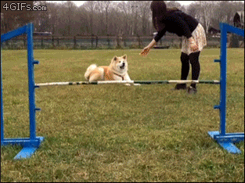
The 3 obstacles every coder faces daily...

Slide 4
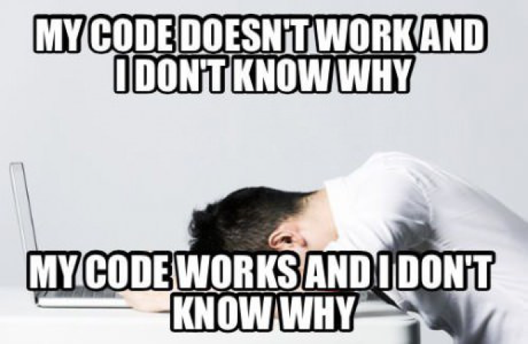
The Great Confusion
Notes:
Making code work is helpful, but it’s more important to learn why your code works or doesn’t work. In this way, you can apply your knowledge to future projects.

Slide 5
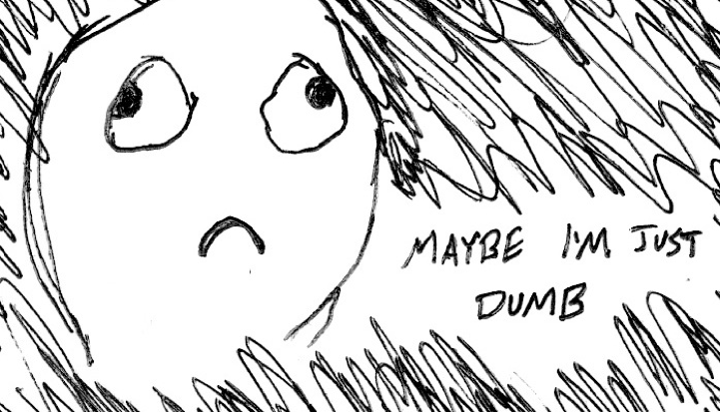
The Great Doubt
Notes:
There will be many moments when you doubt yourself. The key to coding is time not intelligence. You are all intelligent, if you weren’t you would not have been accepted to the University. You are here because we believe in U. The only difference between you and an expert coder is that they have had plenty of time to develop their code vocabulary and understanding of coding languages.

Slide 6

The Great Distance
Notes:
There is PLENTY to learn, and it can be intimidating, but realistically the semester will be over before you know it. Personal issues will come up, and it will be

Slide 7

Learning to code requires 2 things
Notes:
The SECRET

Slide 8

Persistence!!
Notes:
Persistence in finding solutions is a key component in learning to code. If something doesn’t work, question why, see what others say about the problem, test different avenues that may lead to a solution. Don’t give up!

Slide 9


Maintain Self Confidence at all times!!
Notes:
Maintaining your confidence in the face of frustration when learning is key. If you have grown very frustrated with a coding problem, walk away from it and come back to the code problem later with a fresh mind. Above all else, never stop believing in your abilities or yourself. U GOT THIS!

Slide 10

Code Encapsulation is KEY!
Code and test in bite sized pieces. It helps to find errors or problems easily
Notes:
So.. you have put together an unholy mass of code and launch it only to find it doesn’t work? … This is one of the biggest mistakes amateur coders make.

Slide 11

Code Encapsulation is KEY!
Code and test in bite sized pieces. It helps to find errors or problems easily
Notes:
It’s best practice to approach coding by compartmentalizing the different pieces of your project and ensuring that they are functional as you add them to the overall project. Code that uses encapsulation makes it easier to find problems as you go and organizes your code making it easier to reference later.

Slide 12

Remember You are not alone in this Journey
Resources
Your Classmates via Slack (But don’t cheat! Not worth the disciplinary actions)
Resources on Slack, Blackboard & the Weblab Repo Code Examples
Google & Stack Overflow - If you are having an issue chances are so have many other people who have already solved the problem.
Official Documentation/Instructions
Me! via office hours: https://calendly.com/e-rod & eliot@miami.edu

Slide 13


